Slide 1
myADVISE
Derrek Baxter, Blake Emmons, Chris Fuller, Logan Hall, Jared Seeforth, Jonathan Weston
Notes:
20 minute presentation + demo
Objectives
Update class on implemented features
Demo features using the integrated system
Discuss known issues

Slide 2
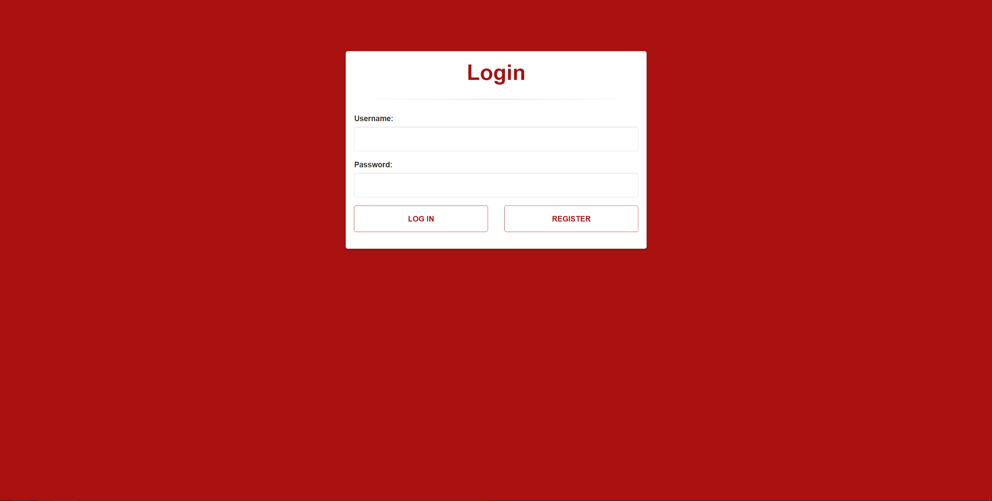
Login

Slide 3
Login
Successfully authenticates users based on credentials
Allows users to register if no account exists for user
If authentication fails, error message is displayed, user is given the option to attempt to log in again.

Slide 4
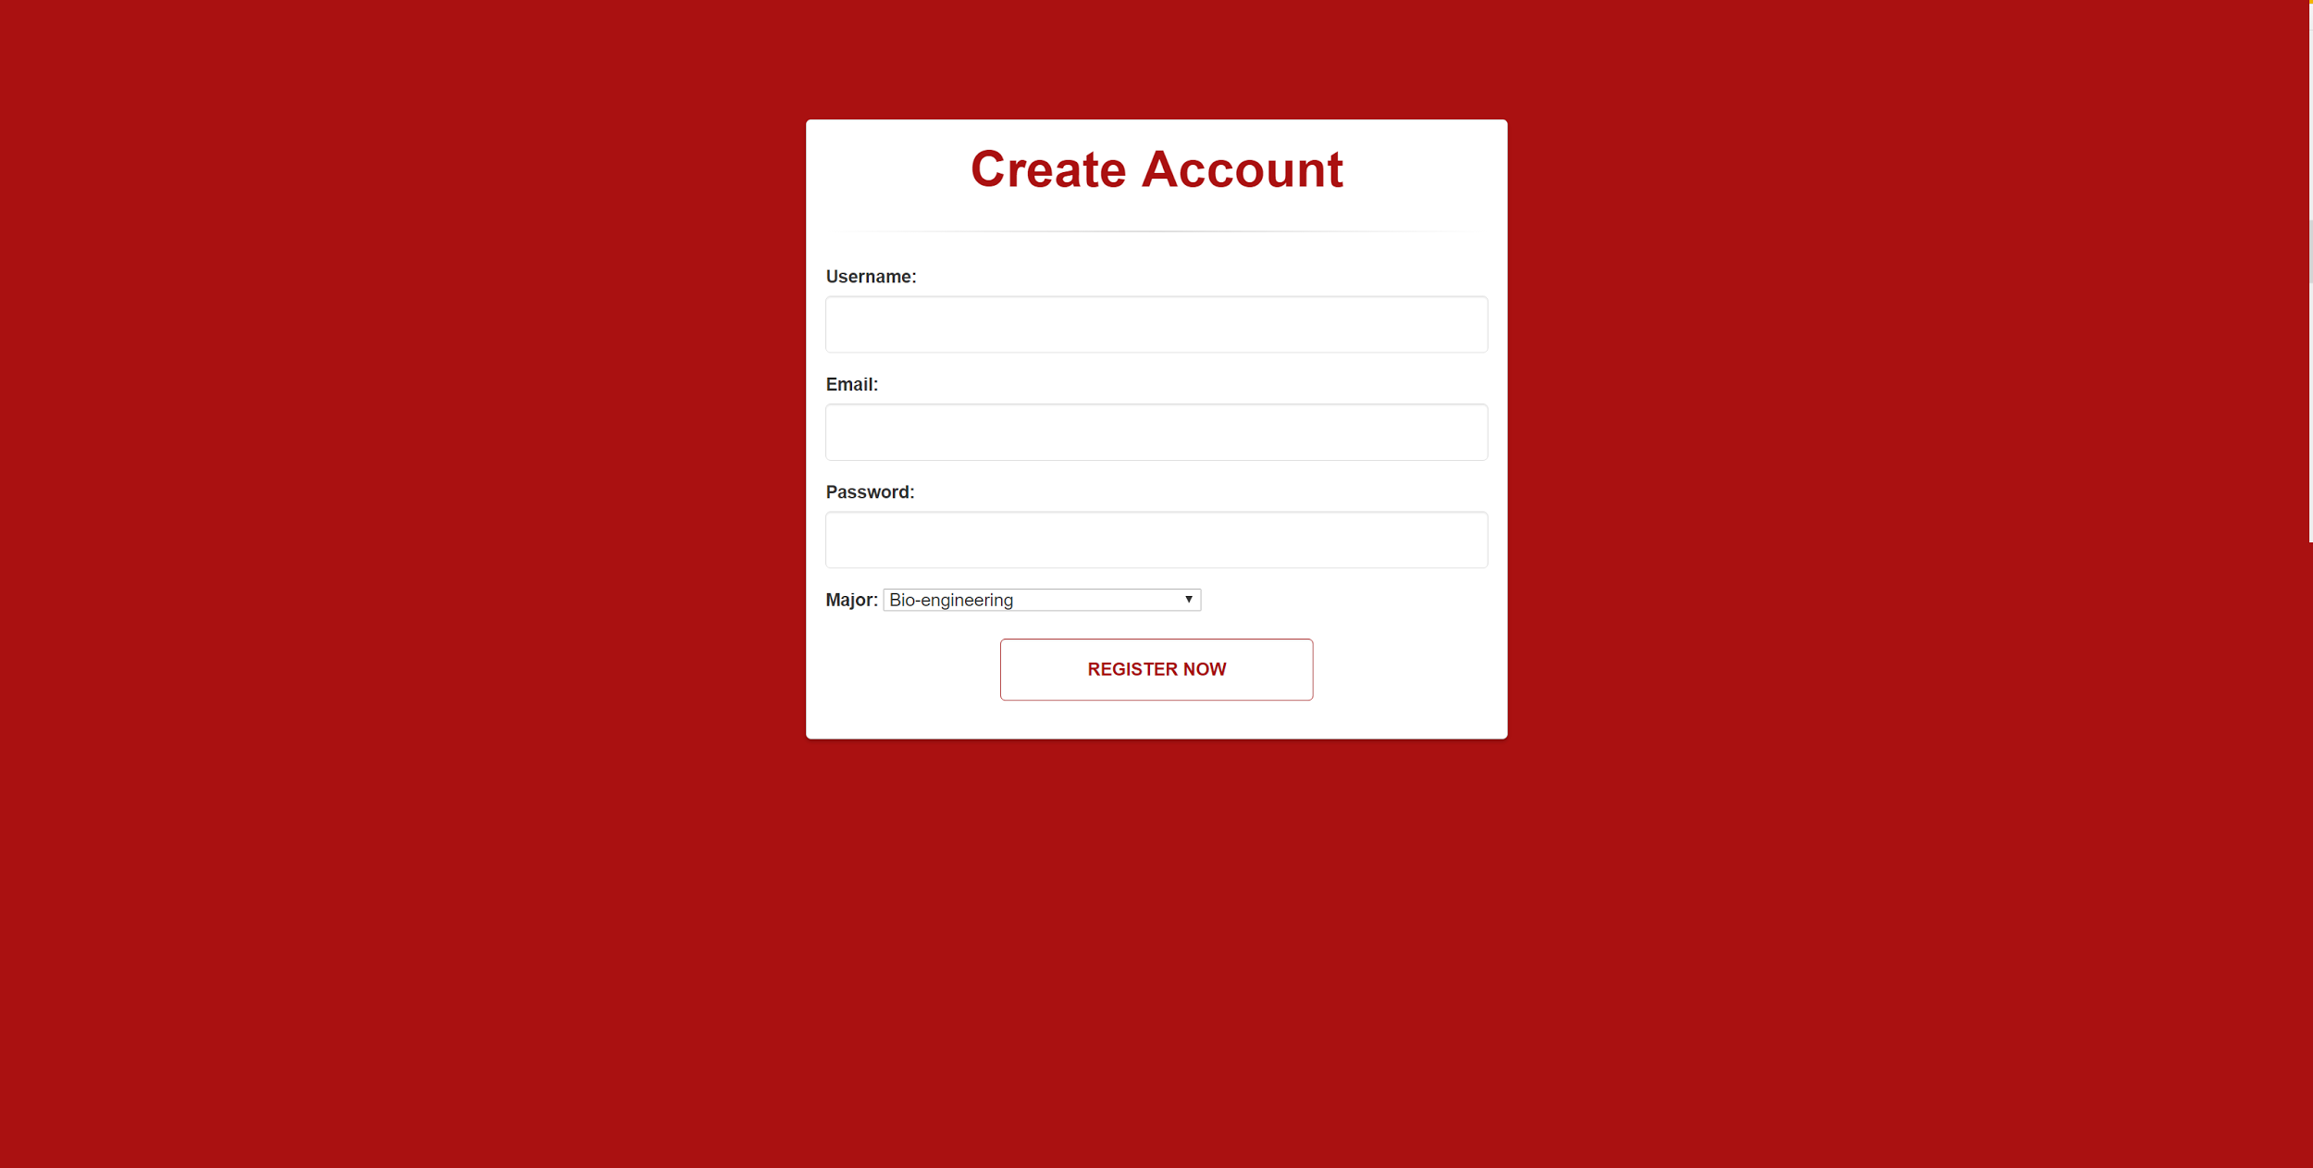
Account Creation

Slide 5
Account Creation
Users can create an account provided they supply valid username, email, and password
Account allows user to specify major
Creation page (upon success) redirects user to homepage.

Slide 6
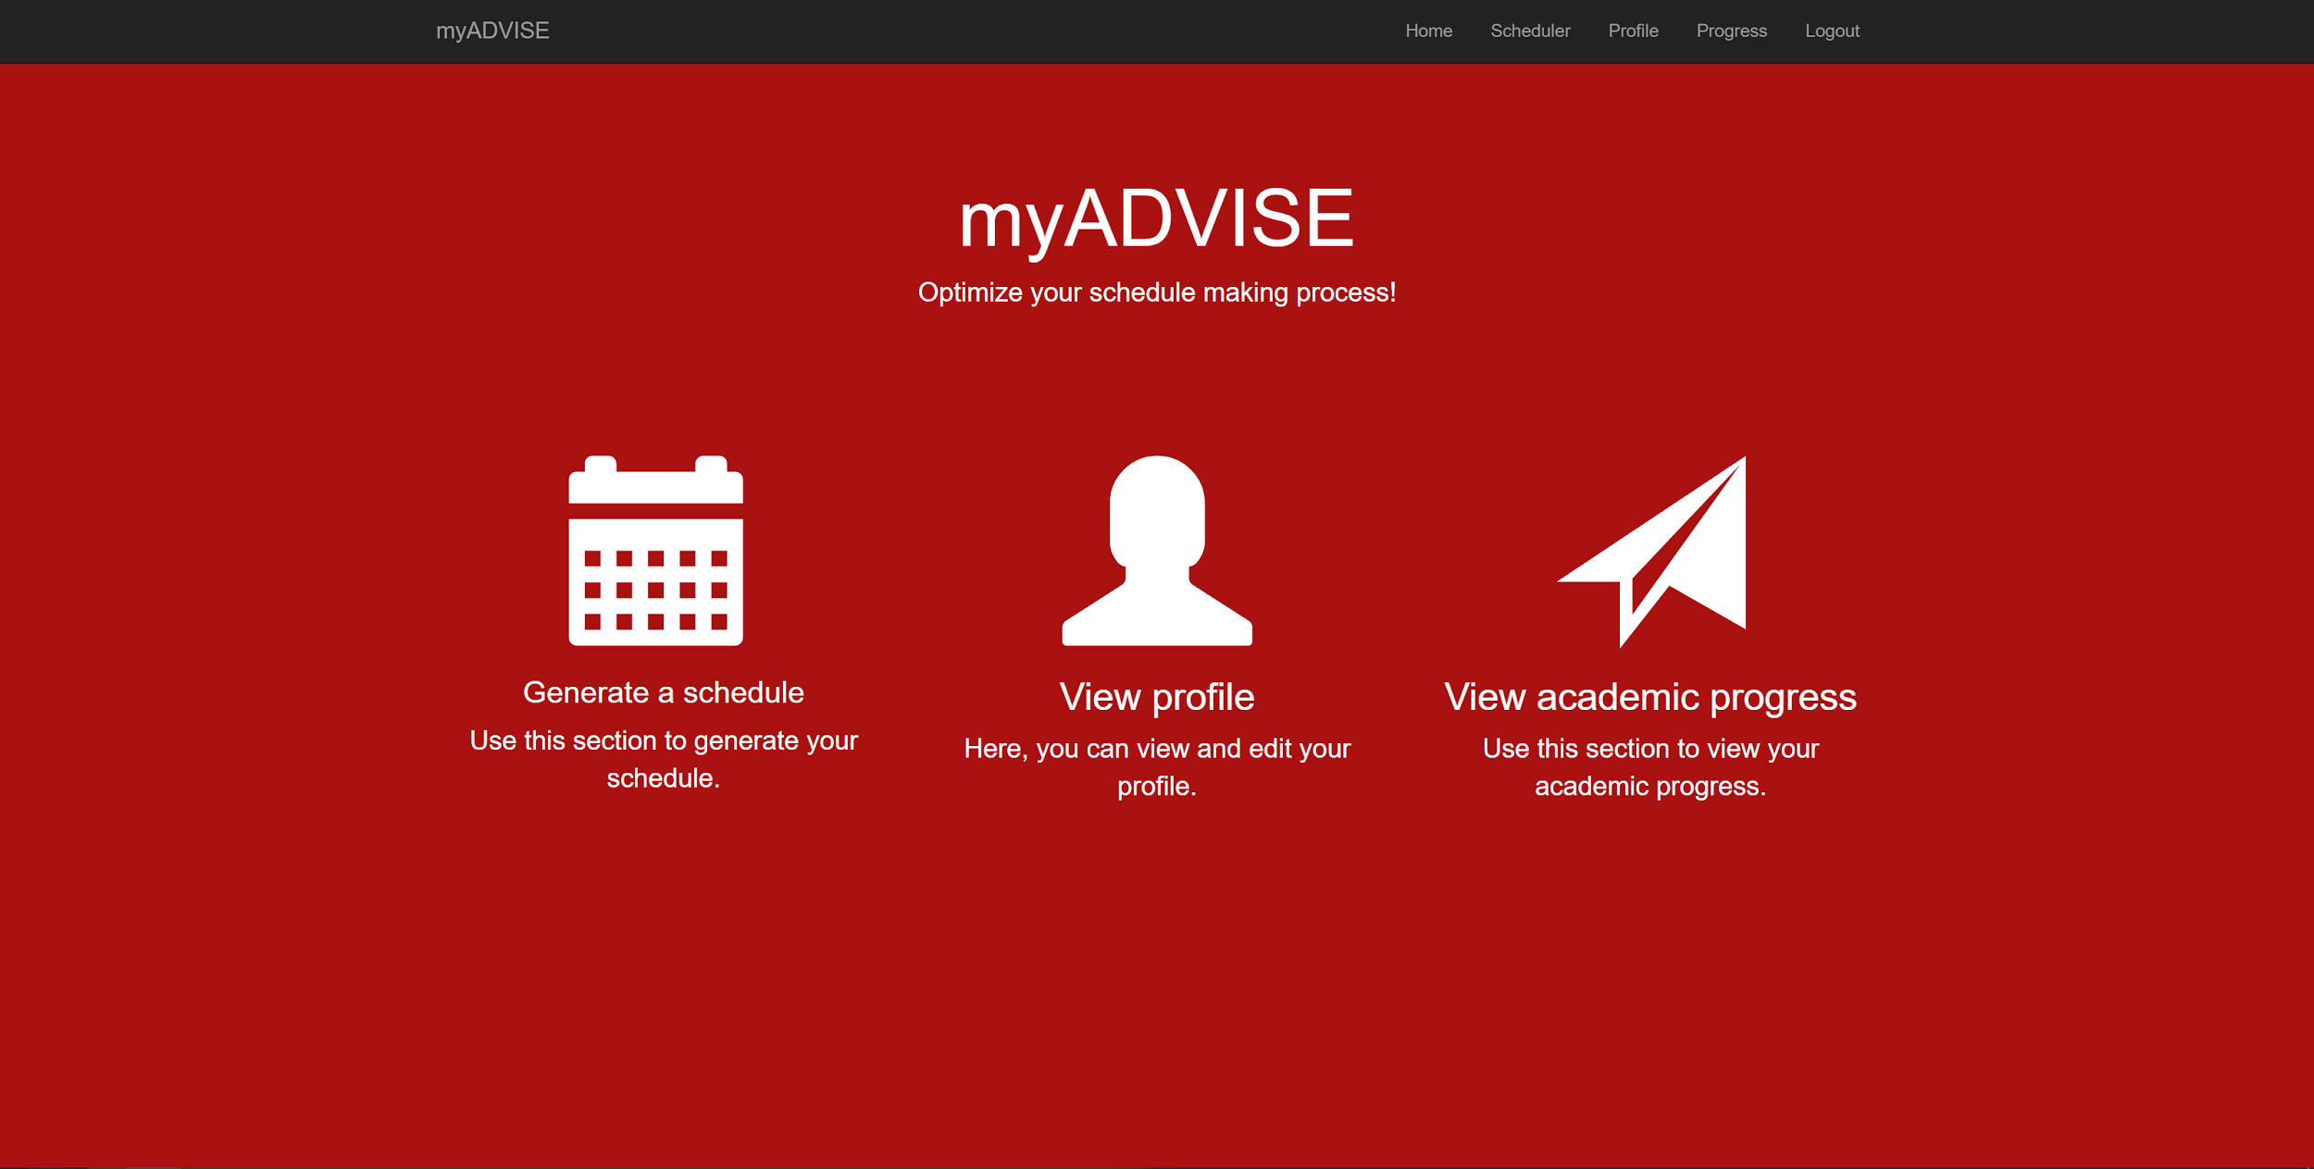
Homepage

Slide 7
Homepage
Is able to navigate between:
Schedule Generation
Profile View
Progress View
Presents information in such a way so to be intuitive to the user

Slide 8
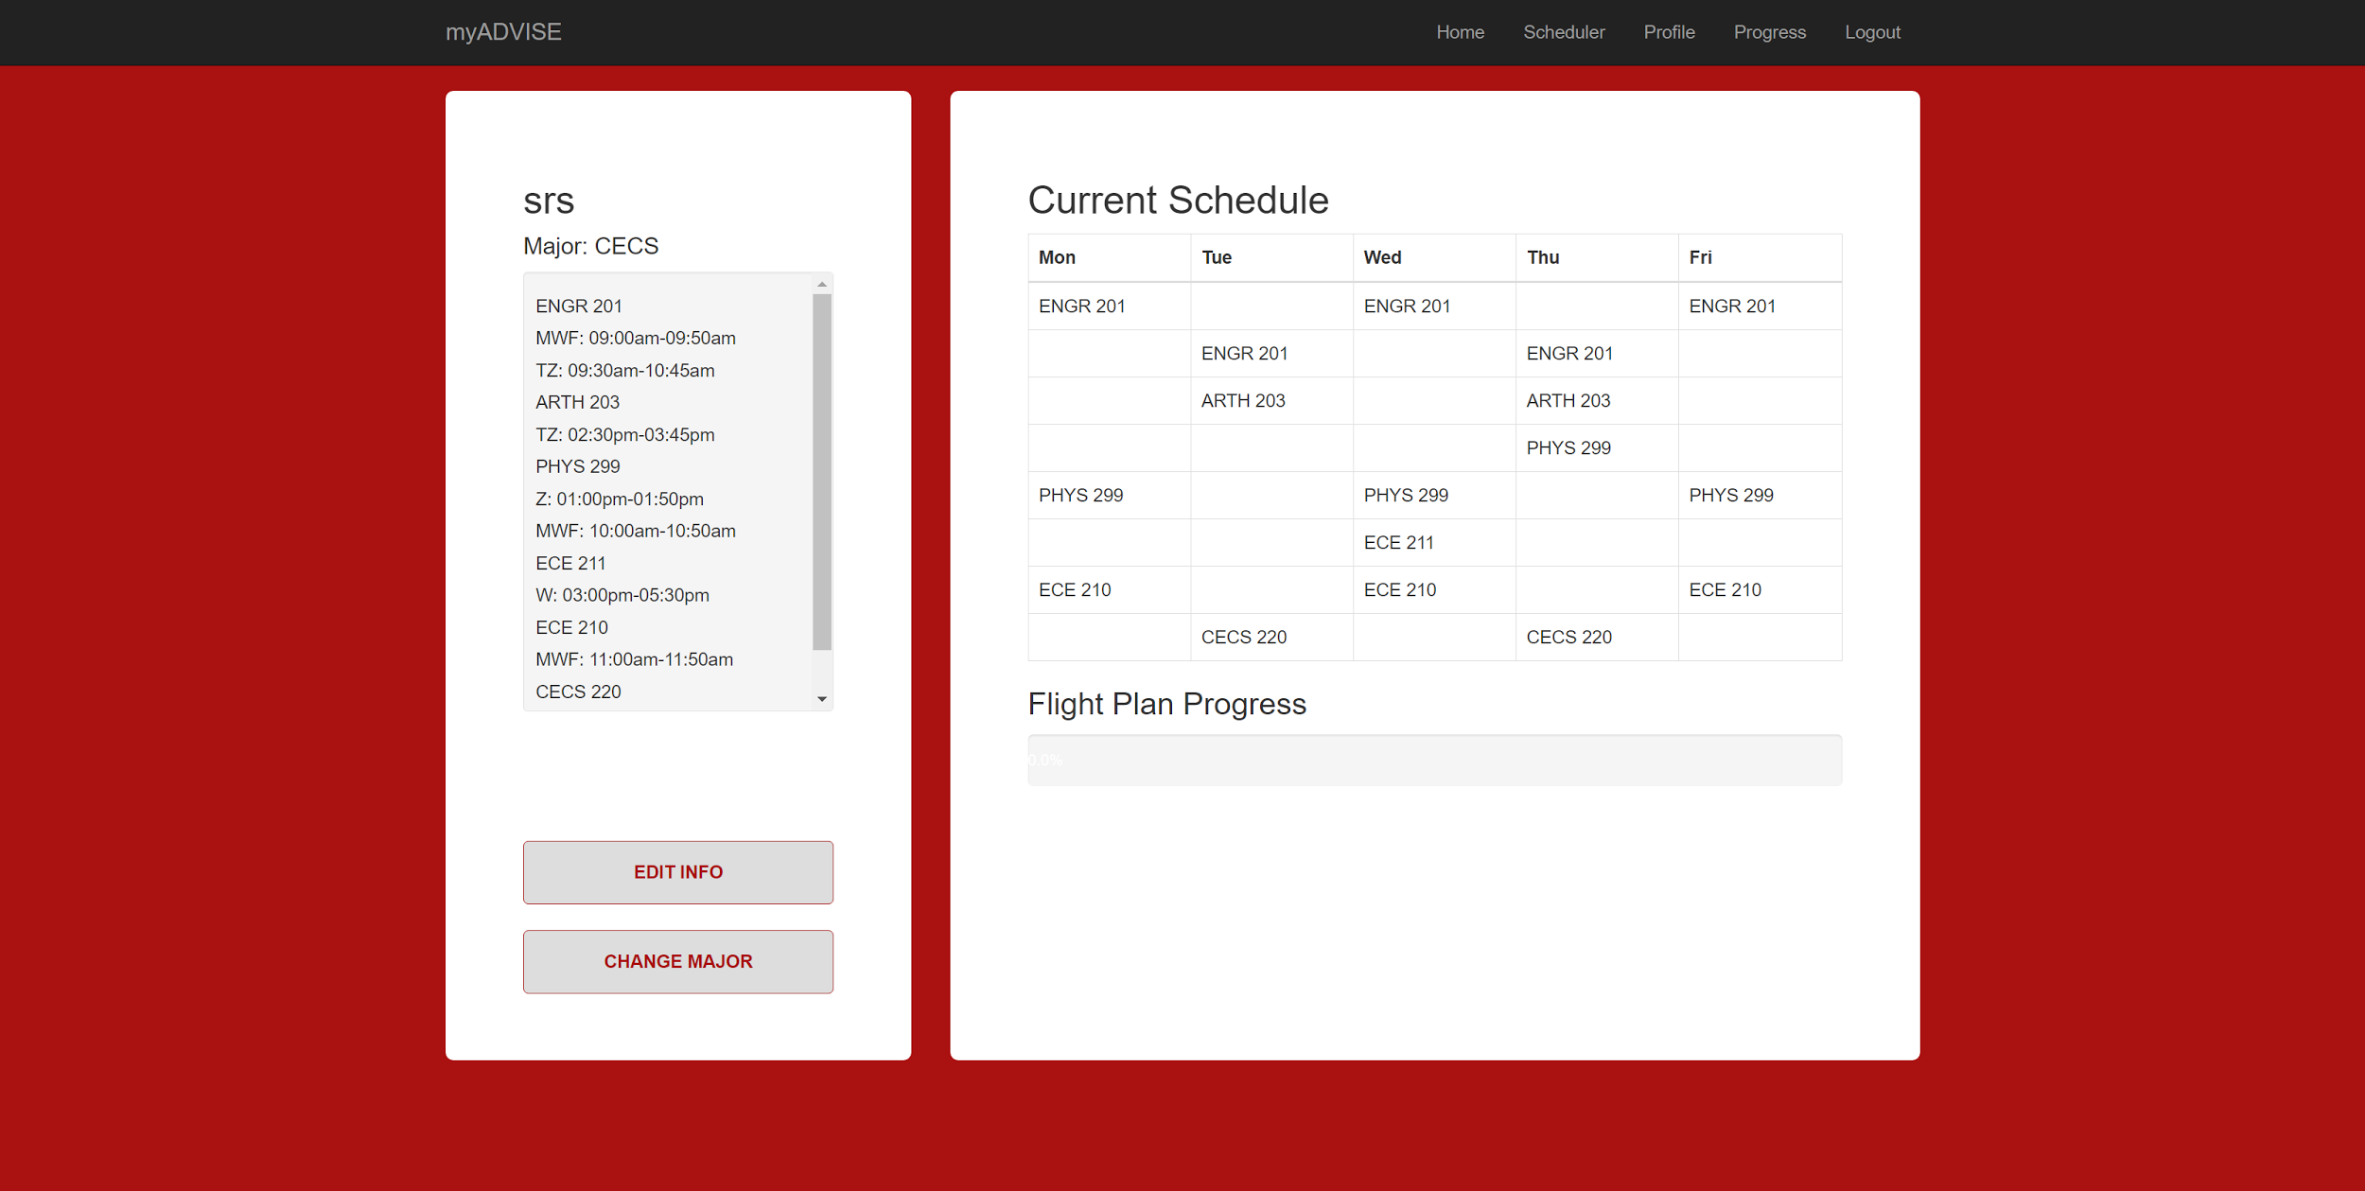
Profile Page

Slide 9
Profile Page
Displays a generated schedule
Weekview
textview
Allows user to update/modify preferences
Allows user to change major
Displays accurate flight plan progress (overall)

Slide 10
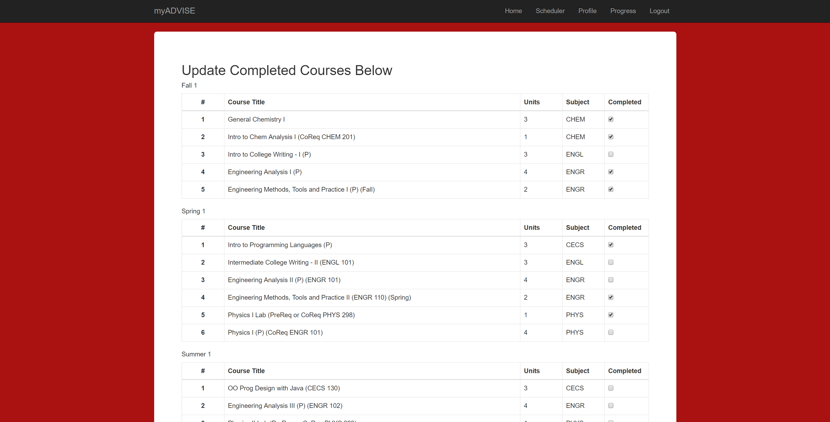
Progress Page

Slide 11
Progress Page
Progress page successfully displays flight plan
Accurately displays course completion based on user history
Allows the user to modify completed course & apply changes

Slide 12
Scheduling Algorithm
Schedules based on flight plan
Takes user preference into account if provided
Prevents time conflicts

Slide 13
Testing

Slide 14
Known Issues
Scheduler does not take into account co/prerequisites
Specific Gen Ed course information is not currently being stored in the user’s progress
Weekview does not display courses at correct times consistently
User preferences are not taken into account when scheduling gen eds
Summer semester handling is not currently supported

Slide 15
Known Issues (Cont.)
Bad/Junk course data persisting in database
Preference dialog does not retrieve current preferences, instead displaying defaults
No access to UofL Course Catalog

Slide 16
Demo

